Slide 1
Communication & Presentation Skills

Slide 2

Preparation

Slide 3

Why?

Slide 4

Who?

Slide 5

What?

Slide 6

How?

Slide 7


Where
And
When?

Slide 8

Performance
Language
Confidence
Eye contact /Gesture/ Body Language
Building Rapport
Dress Code
Smile

Slide 9

Structure
Begin by placing your topic in context
Provide an outline
Tell them what is in it for the audience
Organize the body of the presentation
Ending
Q & A Session

Slide 10

Slides
Font
Minimum number of words
Visuals
Colours
White space

Slide 11

Voice
Projection
Pauses
Pace

Slide 12
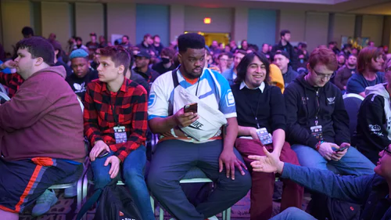
Audience Types
The Know It All
The Monopoliser
The Nit Picker
The Aggressive

Slide 13
Coping With Stage Fear
Your audience understands your nervousness
Nervousness is usually invisible
Be yourself, let the real you come through
Relax, practice some deep breathing techniques
Practice with friends, share your fears with friends
Check out the room first(space, equipment, lights)
Concentrate on the message
Begin with a slow, well prepared introduction
Have a confident & clear conclusion
Be prepared & practice

Slide 14

Rules Of Thumb!
Eye contact
Gesture to A minimum
Enthusiasm and confidence – A must
Avoid awkward physical mannerisms
Be yourself
Smile!

Slide 15


